Slide 1
Role of HMOs in Preterm Nutrition
HMOs在早产儿营养中的作用

Slide 2


Table of contents
目录
1. Prematurity and related health risks
1.早产及其相关健康风险
2. Role of HMOs in preterm infants
2.HMOs在早产儿中的作用
3. Clinical evidence of a HMO supplement (2’FL, LNnT) in preterm infants
3.HMO补充剂（2’FL, LNnT）在早产儿中的临床证据

Slide 3
Prematurity and Related Health Risks
早产及相关健康风险

Slide 4
Definition of Preterm Birth
早产的定义
Preterm birth: when a baby is born too early, before 37 weeks of pregnancy have been completed¹
早产:当婴儿过早出生，即在妊娠未满37周时出生¹
Terminology 术语 | Gestational age 胎龄
Term 足月 | 37 – 40 weeks 37 – 40 周
Preterm 早产 | < 37 weeks < 37 周
Moderate / late preterm 中度/晚期早产 | 32 - 37 weeks 32 - 37 周
Very preterm 极早早产 | 28 - 32 weeks 28 - 32 周
Extremely preterm 极度早产 | < 28 weeks < 28 周
1. WHO 2018 (fact sheet preterm birth)
1. 世界卫生组织 2018 年（早产事实报告）

Slide 5
Preterm babies face specific health risks related to their immaturity / developmental needs¹⁻²
早产儿面临与其未成熟/发育需求相关的特定健康风险¹⁻²
Respiratory Distress Syndrome
呼吸窘迫综合征
Feeding difficulties / metabolic disturbances
喂养困难/代谢紊乱
Jaundice and higher risk for the brain
黄疸和更高的脑损伤风险
Infections
感染
Anaemia of prematurity
早产儿贫血
Brain injury
脑损伤
Retinopathy of prematurity
早产儿视网膜病变
Feeding intolerance
喂养不耐受
NEC
NEC, necrotising enterocolitis
NEC, 坏死性肠炎
1. WHO 2012; 2. WHO 2020 (Born too soon: the global action report on preterm birth)
1. WHO 2012; 2. WHO 2020 (《出生过早：全球早产儿行动报告》)

Slide 6
An immature GI system leads to specific health risks in preterm infants¹⁻⁵
未成熟的胃肠道系统会导致早产儿特定的健康风险¹⁻⁵
Gastrointestinal system
胃肠道系统
Immature gut barrier
未成熟的肠道屏障
Inefficient digestion
消化效率低下
and absorption
和吸收
Immature GI motor functions
未成熟的胃肠道运动功能
Higher vulnerability to
对...更高的易感性
antigens and pathogens
抗原和病原体
Immature digestion of lactose, protein and fat
乳糖、蛋白质和脂肪的消化不成熟
Limited glucose absorption
葡萄糖吸收有限
Poor suck-swallow-coordination
吸吮-吞咽协调不良
Inefficient oesophageal motility
食管运动效率低下
Delayed gastric emptying
胃排空延迟
Slow intestinal transit
肠道传输缓慢
Infection, allergy, NEC
感染、过敏、NEC
Feeding difficulties, risk of insufficient nutrient intakes
喂养困难，营养摄入不足的风险
Feeding intolerance
喂养不耐受
GI, gastrointestinal; NEC, necrotising enterocolitis.
GI，胃肠道；NEC，坏死性小肠结肠炎.
1. Neu J, 2007; 2. Neu J, 2008; 3. Blackburn ST, 2013; 4. Omari TI and Rudolph CD, 2011; 5. Premji SS, 1998

Slide 7
A disturbed microbial colonisation of the GI tract contributes to feeding intolerance of preterm infants¹⁻⁸
肠道微生物群的紊乱定植导致早产儿喂养不耐受¹⁻⁸
Disturbed gut microbial colonisation
肠道微生物群紊乱定植
Internal risk factors⁷⁻¹⁰
内部风险因素⁷⁻¹⁰
Gestational age
孕周
Birth weight
出生体重
Genetics
遗传
In utero colonisation
宫内定植
Delayed colonization of commensal bacteria, such as Bifidobacteria, Lactobacillus
共生细菌如双歧杆菌和乳酸杆菌的延迟定植
Limited microbial diversity
微生物多样性有限
Microbial disturbances persist up to 4 years of age
微生物紊乱可持续到4岁
External risk factors⁷⁻¹¹
外部风险因素⁷⁻¹¹
Antibiotics
抗生素
Mode of delivery
分娩方式
NICU environment
NICU环境
Skin to skin contact
皮肤接触
Breast milk exposure
母乳暴露
Medical complexity, inflammation, oxidative stress
医疗复杂性，炎症，氧化应激
Feeding intolerance, NEC, impact on immune system development and gut barrier integrity
喂养不耐受，NEC，对免疫系统发育和肠屏障完整性的影响
GI, gastrointestinal; NEC, necrotising enterocolitis; NICU, neonatal intensive care unit.
GI，胃肠道；NEC，坏死性小肠结肠炎；NICU，新生儿重症监护室。
1. Di Mauro A et al., 2013; 2. Ford SL et al., 2019; 3. Fanaro S, 2013; 4. Senterre T, 2014; 5. Fouhy F et al., 2019; 6. Yuan Z et al., 2019;
1. Di Mauro A 等，2013；2. Ford SL 等，2019；3. Fanaro S，2013；4. Senterre T，2014；5. Fouhy F 等，2019；6. Yuan Z 等，2019；
7. Collado C et al., 2015; 8. Hendrickx JGE et al., 2019; 9. Lenfestey MW and Neu J, 2018; 10. Unger S et al., 2015; 11. Greenwood C et al., 2014.
7. Collado C 等，2015；8. Hendrickx JGE 等，2019；9. Lenfestey MW 和 Neu J，2018；10. Unger S 等，2015；11. Greenwood C 等，2014。

Slide 8



Up to 50% of preterm babies suffer from feeding intolerance¹
高达50%的早产儿患有喂养不耐受¹
Risk factors^{2,3}
风险因素^{2,3}
Feeding Intolerance*
喂养不耐受*
Consequences^{2,3}
后果^{2,3}
Functional immaturity of the GI tract
胃肠道功能未成熟
Lack of coordinated GI motility
缺乏协调的胃肠道运动
Impaired digestive function
消化功能受损
Disturbed gut microbial colonisation
肠道微生物定植紊乱
Suboptimal nutrient intake
营养摄入不足
Decreased growth rate
生长速度下降
Delayed achievement of full enteral feeding
全肠内喂养延迟实现
Prolonged dependence on intravenous nutrition
长期依赖静脉营养
Inability to meet criteria for NICU discharge
无法满足NICU出院标准
*Feeding intolerance can be defined by the inability to digest enteral feedings (GRV > 50%), abdominal distension or emesis or both, and the disruption of the patient's feeding plan.²
*喂养不耐受可以定义为无法消化肠内喂养（GRV > 50%）、腹胀或呕吐或两者兼有，并且干扰患者的喂养计划。²
GI, gastrointestinal; GRV, gastric residual volume; NICU, neonatal intensive care unit.
GI，胃肠道；GRV，胃残留量；NICU，新生儿重症监护室。
1. Indrio F et al., 2011; 2. Fanaro S, 2013; 3. Senterre T, 2014.
1. Indrio F 等，2011；2. Fanaro S，2013；3. Senterre T，2014。

Slide 9

Achieving timely enteral feeding is critical to support and development of preterm babies
及时肠内喂养对于支持和促进早产儿的发育至关重要
Benefits of timely enteral feeding¹⁻⁴
及时肠内喂养的好处¹⁻⁴
Promote growth
促进生长
Support normal development of the GI tract
支持胃肠道的正常发育
Promote nutrient intake
促进营养摄入
Support neurodevelopment and long-term health outcomes
支持神经发育和长期健康结果
Minimise the risk of NEC
降低NEC的风险
Avoid health problems related to feeding by intravenous lines
避免与静脉输液喂养相关的健康问题
GI, gastrointestinal; NEC, necrotising enterocolitis.
GI，胃肠道；NEC，坏死性小肠结肠炎。
1. Fanaro S, 2013; 2. Senterre T, 2014; 3. Koletzko B, 2014; 4. Chen CM, 2012.

Slide 10
Role of HMO in Preterm Infants
HMO在早产儿中的作用
HMO, Human milk oligosaccharide.
HMO，人乳低聚糖。

Slide 11
HMOs may play a role in mitigating the effects of NEC^{1,2*}
HMOs 可能有助于减轻 NEC 的影响^{1,2*}
Pooled HMO¹
混合 HMO¹
Pooled HMO, 2’FL²
混合 HMO，2’FL²
*** p<0.001, **p<0.01
2’FL, 2-fucosyllactose; DF, dam fed; FF, formula fed; GOS, galacto-oligosaccharide; HMO, human milk oligosaccharide; NEC, necrotising enterocolitis; Sia, sialylated.
2’FL，2-岩藻糖基乳糖；DF，母乳喂养；FF，配方奶喂养；GOS，半乳寡糖；HMO，人乳低聚糖；NEC，坏死性小肠结肠炎；Sia，唾液酸化。
1. Jantscher-Krenn E et al., 2012; 2. Autran CA et al., 2016. * Animal model.
1. Jantscher-Krenn E 等，2012；2. Autran CA 等，2016。 * 动物模型。

Slide 12
HMOs may play a role in mitigating the effects of NEC^{1*}
HMOs 可能在减轻 NEC 的影响中发挥作用^{1*}
Low HMO diversity is associated with NEC in preterm infants
低 HMO 多样性与早产儿 NEC 相关
HMO, human milk oligosaccharide; NEC, necrotising enterocolitis; PMW, post menstrual week
HMO，人乳低聚糖；NEC，坏死性小肠结肠炎；PMW，月经后周数
1. Wejryd E et al., 2018. *Observational study.
1. Wejryd E 等，2018。*观察性研究。

Slide 13
HMOs may influence NEC severity by reducing TNF-𝜶 and TLR4 mediated signaling1*
^{H}MOs 可能通过减少 TNF-𝜶 和 TLR4 介导的信号传导来影响 NEC 的严重程度1*
2’FL and 6’SL reduce NEC severity
2’FL 和 6’SL 减轻 NEC 的严重程度
2’FL and 6’SL reduce levels of proinflammatory TNF-𝜶 alpha
2’FL 和 6’SL 降低促炎性 TNF-𝜶 水平
*** p<0.001
2’FL, 2-fucosyllactose; 6’SL, 6-sialyllactose; HMO, human milk oligosaccharide; Lac, lactose; NEC, necrotising enterocolitis;
2’FL, 2-岩藻糖基乳糖；6’SL, 6-唾液酸乳糖；HMO, 人乳寡糖；Lac, 乳糖；NEC, 坏死性小肠结肠炎；
qRT-PCR, quantitative real-time polymerase chain reaction; TLR4, toll-like receptor 4; TNF-𝜶, tumor necrosis factor alpha.
qRT-PCR, 定量实时聚合酶链反应；TLR4, Toll 样受体 4；TNF-𝜶, 肿瘤坏死因子 α。
1. Sodhi CP et al., 2020. *Animal studies in combination with experimental studies
1. Sodhi CP 等，2020。*动物研究结合实验研究

Slide 14
Fucosylated HMOs may reduce gut microbiota dysbiosis in premature infants^{1*}
岩藻糖基化HMO可能减少早产儿肠道微生物群失调^{1*}
Fucosylated HMOs
岩藻糖基化HMO
Non-Fucosylated/ non-sialylated HMOs
非岩藻糖基化/非唾液酸基化HMO
R²=0.63, p=0.002
R²=0.48, p=0.01
R²=0.36, p=0.04
R²=0.42, p=0.02
Higher levels of fucosylated HMOs are associated with:
较高水平的岩藻糖基化HMO与以下因素相关：
Higher levels of commensal Firmicutes
较高水平的共生菌Firmicutes
Lower levels of primarily harmful Proteobacteria
较低水平的主要有害菌Proteobacteria
Higher levels of non-fucosylated or non-sialylated
较高水平的非岩藻糖基化或非唾液酸基化
HMOs are associated with:
HMO与以下因素相关：
Lower levels of commensal Firmicutes
较低水平的共生菌Firmicutes
Lower levels of primarily harmful Proteobacteria
较低水平的主要有害菌Proteobacteria
HMO, human milk oligosaccharide.
HMO，人乳寡糖。
1. Underwood MA et al., 2013. *Observational study, n=12.
1. Underwood MA 等，2013。 *观察研究，n=12。

Slide 15
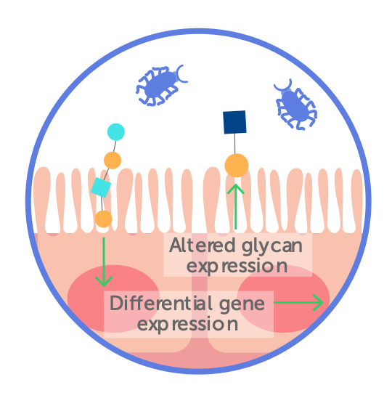
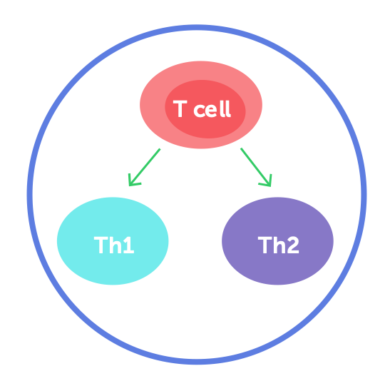
HMOs help the immune defences in 4 main ways¹⁻⁵
HMOs以四种主要方式帮助免疫防御¹⁻⁵
Promote the growth of beneficial bacteria
促进有益细菌的生长
Prevent pathogen adhesion in the gut
防止病原体在肠道内黏附
Strengthen gut barrier function
增强肠道屏障功能
Educate the developing
教育发育中的
immune system
免疫系统
+HMOs
+HMOs
+HMOs
+HMOs
HMO, human milk oligosaccharide.
HMO，人乳寡糖。
1. Underwood MA et al., 2013; 2. Zivkovic AM et al., 2011; 3. Zivkokiv AM et al., 2013; 4. Bode L, 2015; 5. Donovan SM et al., 2016.
1. Underwood MA 等，2013；2. Zivkovic AM 等，2011；3. Zivkokiv AM 等，2013；4. Bode L，2015；5. Donovan SM 等，2016。

Slide 16
Most levels of HMOs are lower in preterm milk compared to term milk, at equivalent developmental status¹*
大多数 HMO 的水平在同等发育状态下，早产儿乳中比足月乳低¹*
The largest differences are seen around 40 postmenstrual weeks
最大的差异出现在约 40 周月经后
2’FL
LNnT
c
c
a
a
c
c
Term milk
足月乳
Preterm milk
早产儿乳
a, p<0.05
c, p<0.0005
2’FL, 2-fucosyllactose; HMO, human milk oligosaccharide; LNnT, Lacto-N-neotetraose.
2’FL，2-岩藻糖基乳糖；HMO，人乳寡糖；LNnT，乳-N-新四糖。
1. Austin S et al., 2019. *Observational study
1. Austin S 等，2019。 *观察性研究

Slide 17


Preterm infants may have insufficient HMO intake
早产儿可能摄入不足的HMO
Mother’s own milk
母乳
Donor milk
捐赠乳
Alternative feeds
替代喂养
Levels of HMOs may be reduced¹
HMO水平可能降低¹
Pasteurisation and sterilisation reduce levels of HMOs in donor milk^{2,3}
巴氏消毒和灭菌会降低捐赠乳中的HMO水平^{2,3}
Do not currently contain HMOs
目前不含有HMO
HMO, human milk oligosaccharide.
HMO，人乳寡糖。
1. Austin S et al., 2019; 2. Marx C et al., 2014; 3. Meredith-Dennis L et al., 2018.
1. Austin S 等，2019；2. Marx C 等，2014；3. Meredith-Dennis L 等，2018。

Slide 18
HMOs are the 3rd largest solid component in human milk
HMOs 是母乳中第三大固体成分
> 200 HMOs identified
已鉴定出 > 200 种 HMOs
20-30 HMOs quantified⁴⁻¹¹
定量分析了 20-30 种 HMOs⁴⁻¹¹
Three main HMO categories based on their building blocks⁴⁻¹¹
基于其构建单元的三种主要 HMO 类别⁴⁻¹¹
Solid components¹⁻³
固体成分¹⁻³
Proteins (8 g/L)
Non-fucosylated neutral (core) HMOs
非岩藻糖基化的中性（核心）HMOs
e.g., LNnT, LNT
例如，LNnT，LNT
HMOs (5-15 g/L)
Lipids (40 g/L)
Fucosylated neutral HMOs
岩藻糖基化的中性 HMOs
e.g., 2’FL, DFL
例如，2’FL，DFL
Lactose (70 g/L)
Sialylated acidic HMOs
唾液酸化的酸性 HMOs
e.g., 6’SL, 3’SL
例如，6’SL，3’SL
DFL, difucosyllactose (also named as LDFT, lactodifucotetraose); DFLNHa, difucosyllacto-N-hexaose a; DSNLT, disialyllacto-N-tetraose; FL, fucosyllactose; HMO, human milk oligosaccharide; LNDFH, lacto-N-difucohexaose; LNFP, lacto-N-fucopentaose; LNT, lacto-N-tetraose; LNnT, Lacto-N-neotetraose; LST, sialyl-lacto-N-tetraose; MFLNH, monofucosyllacto-N-hexaose; SL, sialyllactose.
DFL，二岩藻糖基乳糖（也称为 LDFT，乳二岩藻糖四糖）；DFLNHa，二岩藻糖基乳-N-六糖 a；DSNLT，二唾液酸乳-N-四糖；FL，岩藻糖基乳糖；HMO，人乳低聚糖；LNDFH，乳-N-二岩藻糖六糖；LNFP，乳-N-岩藻糖五糖；LNT，乳-N-四糖；LNnT，乳-N-新四糖；LST，唾液酸乳-N-四糖；MFLNH，单岩藻糖基乳-N-六糖；SL，唾液酸乳糖。
1. Zivkovic AM et al., 2011; 2. Zivkokiv AM et al., 2013; 3. Bode L, 2012; 4. Hennet T et al., 2014; 5. Bode L, 2015; 6. Thurl S et al., 2017; 7. Austin S et al., 2016; 8. Sprenger N et al., 2017; 9. Samuel TM et al.,2019; 10. Austin S et al., 2019; 11. Lefebvre G et al., 2020.
1. Zivkovic AM 等，2011；2. Zivkokiv AM 等，2013；3. Bode L，2012；4. Hennet T 等，2014；5. Bode L，2015；6. Thurl S 等，2017；7. Austin S 等，2016；8. Sprenger N 等，2017；9. Samuel TM 等，2019；10. Austin S 等，2019；11. Lefebvre G 等，2020。

Slide 19
Clinical Evidence of a HMO Supplement (2’FL, LNnT) in Preterm Infants
早产儿 HMO 补充剂（2’FL, LNnT）的临床证据
HMO, Human milk oligosaccharide.
HMO，人乳低聚糖。

Slide 20
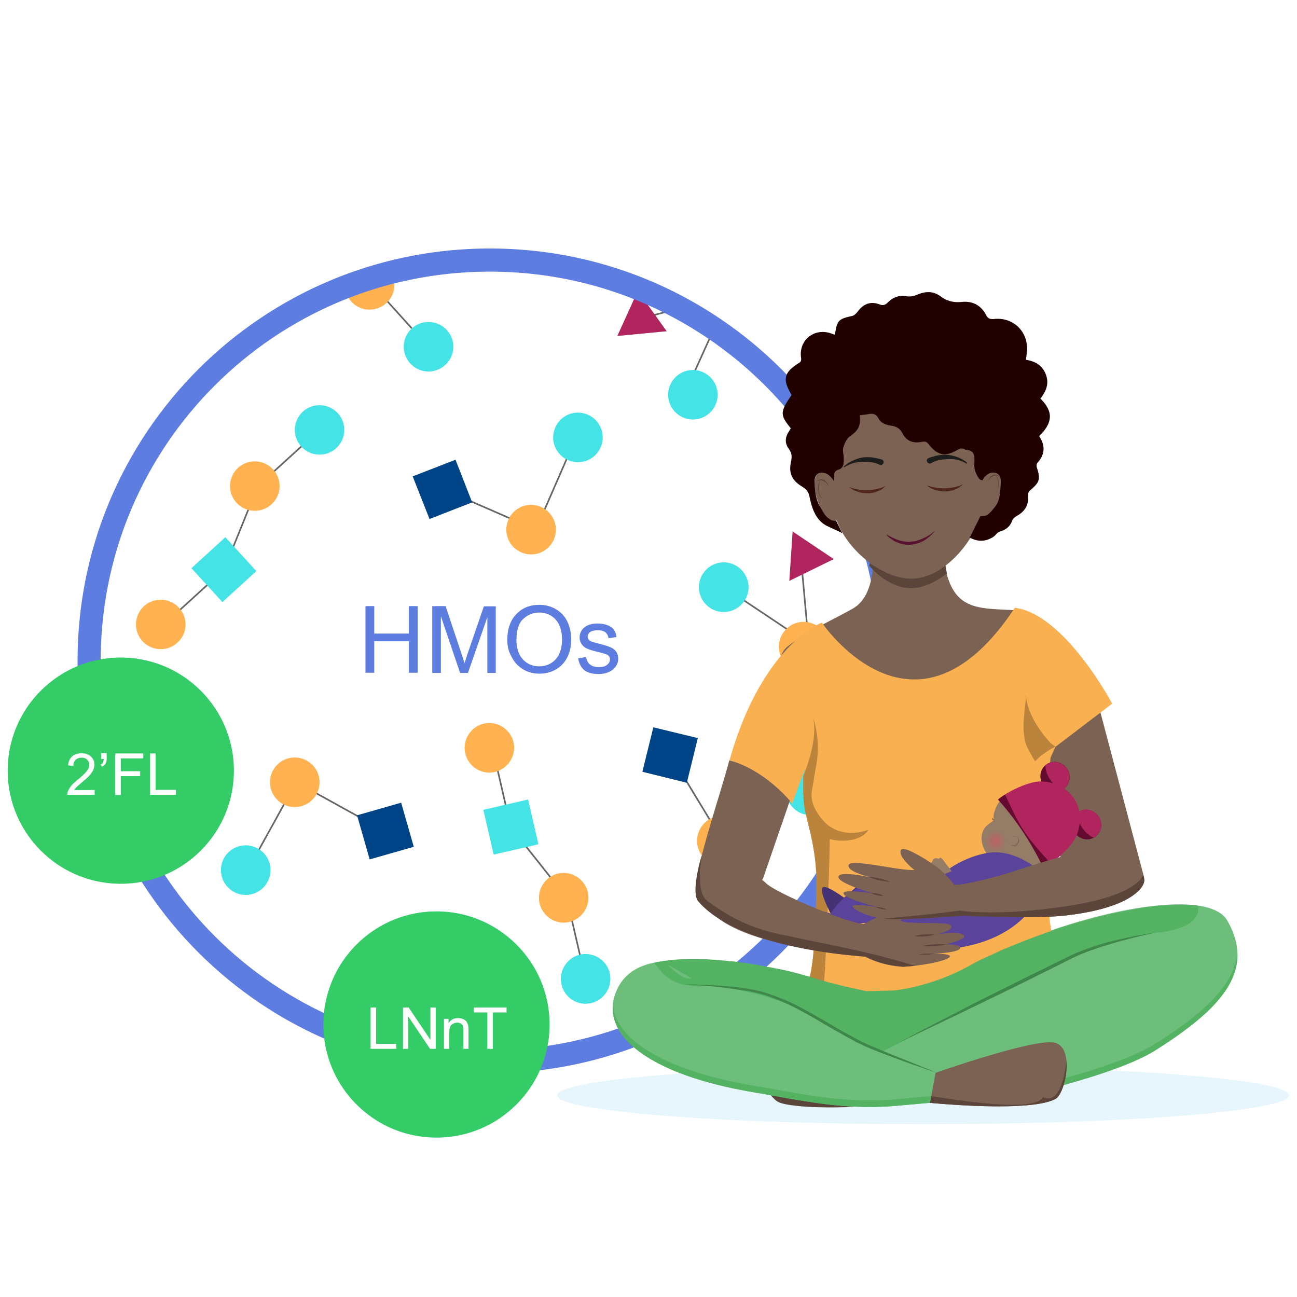
With HMO supplement (2’FL and LNnT), the mean
添加HMO（2’FL和LNnT）后，平均
time to reach full enteral feedingwas 2 days shorter^{1*}
达到全肠喂养的时间缩短了2天^{1*}
Full enteral feeding^
Placebo
(n=43)
14,3
HMO (2’FL, LNnT) supplement
(n=43)
12,2
2 days shorter
0
5
10
15
Faster progression to FEF may help reduce the risk of growth restriction and exacerbated gut immaturity¹
更快地进展到全肠喂养可能有助于降低生长受限和肠道不成熟加剧的风险¹
^Time to reach full enteral feeding is a reliable indicator of feeding tolerance
^达到全肠喂养的时间是喂养耐受性的可靠指标
2’FL, 2-fucosyllactose; HMO, human milk oligosaccharide; LNnT, Lacto-N-neotetraose.
2’FL，2-岩藻糖基乳糖；HMO，人乳寡糖；LNnT，乳-N-新四糖。
1. Hascoët JM et al., Abstract at WCPGHAN 2021. * Randomised, clinical trial
1. Hascoët JM 等，WCPGHAN 2021 摘要。* 随机临床试验

Slide 21
HMO supplement (2’FL and LNnT) supports adequate growth, in line with preterm growth standards^
HMO补充剂（2’FL和LNnT）支持适当的生长，符合早产儿生长标准^
HMO supplement supports early postnatal growth, which may have a positive impact on long-term growth and developmental outcomes^{1*}
HMO补充剂支持早期产后生长，可能对长期生长和发育结果产生积极影响^{1*}
Weight-for-age Z-scores
年龄别体重Z评分
Length-for-age Z-scores
年龄别身长Z评分
^Fenton growth standards for preterm infants
^Fenton 早产儿生长标准
2’FL, 2-fucosyllactose; FEF, full enteral feeding; HMO, human milk oligosaccharide; LNnT, Lacto-N-neotetraose
2’FL，2-岩藻糖基乳糖；FEF，全肠内喂养；HMO，人乳寡糖；LNnT，乳-N-新四糖
1. Hascoët JM et al., Abstract at WCPGHAN 2021. * Randomised, clinical trial
1. Hascoët JM 等，WCPGHAN 2021 大会摘要。* 随机临床试验

Slide 22

HMO supplement (2’FL and LNnT) supports adequate growth, in line with preterm growth standards^
HMO补充剂（2’FL和LNnT）支持适当的生长，符合早产儿生长标准^
Head circumference-for-age Z-scores
年龄别头围Z评分
HMO supplement supports early postnatal growth, which may have a positive impact on long-term growth and developmental outcomes^{1*}
HMO补充剂支持早期产后生长，可能对长期生长和发育结果产生积极影响^{1*}
^Fenton growth standards for preterm infants
^Fenton 早产儿生长标准
2’FL, 2-fucosyllactose; FEF, full enteral feeding; HMO, human milk oligosaccharide; LNnT, Lacto-N-neotetraose
2’FL，2-岩藻糖基乳糖；FEF，全肠内喂养；HMO，人乳寡糖；LNnT，乳-N-新四糖
1. Hascoët JM et al., Abstract at WCPGHAN 2021. * Randomised, clinical trial
1. Hascoët JM 等，WCPGHAN 2021 摘要。* 随机临床试验

Slide 23
HMO supplement (2’FL and LNnT) supports adequate gastrointestinal tolerance
HMO补充剂（2’FL和LNnT）支持良好的胃肠道耐受性
 | HMO Range of means 均值范围 | Placebo 安慰剂 Range of means
Daily gastric residual volume 每日胃残余量 (in mL/kg/day) (单位：mL/kg/天) | 0.05 - 3.06 | 0.07 - 3.29
Daily stool frequency 每日大便次数 | 3.09 - 4.17 | 3.11 - 4.20
Stool consistency 大便性状 (1=watery, 2=runny, 3=mushy soft, 4=formed, 5=hard) (1=水样, 2=稀便, 3=软糊状, 4=成形, 5=硬便) | 2.97 - 3.11 | 2.91 - 3.19
Difference from stool consistency of 3 与3级（软糊状）大便性状的差异 (mushy soft) (软糊状) | 0.13 - 0.33 | 0.16 - 0.50
Gastrointestinal tolerance¹*
胃肠道耐受性¹*
2’FL, 2-fucosyllactose; FEF, full enteral feeding; HMO, human milk oligosaccharide; LNnT, Lacto-N-neotetraose
2’FL, 2-岩藻糖基乳糖；FEF，全肠内喂养；HMO，人乳寡糖；LNnT，乳-N-新四糖
1. Hascoët JM et al., Abstract at WCPGHAN 2021. * Randomised, clinical trial
1. Hascoët JM 等，WCPGHAN 2021 大会摘要。* 随机临床试验

Slide 24
Takeaway message
要点总结
Preterm infants are a vulnerable group of neonates which may have insufficient HMO intake.
早产儿是一群易受伤害的新生儿，可能摄入不足的人乳低聚糖。
Supplementing the HMO 2’FL and LNnT promotes early full enteral feeding versus placebo.
补充人乳低聚糖 2’FL 和 LNnT 可促进早期全肠内喂养，优于安慰剂。
Faster progression to full enteral feeding may help reduce the risk of growth restriction and exacerbated gut immunity.
更快地进展到全肠内喂养可能有助于降低生长受限和肠道免疫加剧的风险。
HMO supplement (2’FL and LNnT) supports early postnatal growth, which may have a positive impact on long-term growth and developmental outcomes.
人乳低聚糖补充剂（2’FL 和 LNnT）支持早期产后生长，可能对长期生长和发育结果产生积极影响。
2’FL, 2-fucosyllactose; FEF, full enteral feeding; HMO, human milk oligosaccharide; LNnT, Lacto-N-neotetraose.
2’FL, 2-岩藻糖基乳糖；FEF，全肠内喂养；HMO，人乳低聚糖；LNnT，乳-N-新四糖。

